Slide 1



Facebook facial recognition
Facebook can identify your face. Creepy or cool? You decide
Notes:
The article discussed Facebook's new face recognition features, that were introduced in 2018. The features included a setting that would automatically notify users if someone else uploaded a photo of them, as well as an expanded facial recognition system that would suggest tags for users in photos.
For this technology they used machine learning algorithms to analyze facial features and create a unique "faceprint" for each individual. The article also discusses concerns about the accuracy of the technology and the potential for misuse of users' facial data.

Slide 2


Slide 3
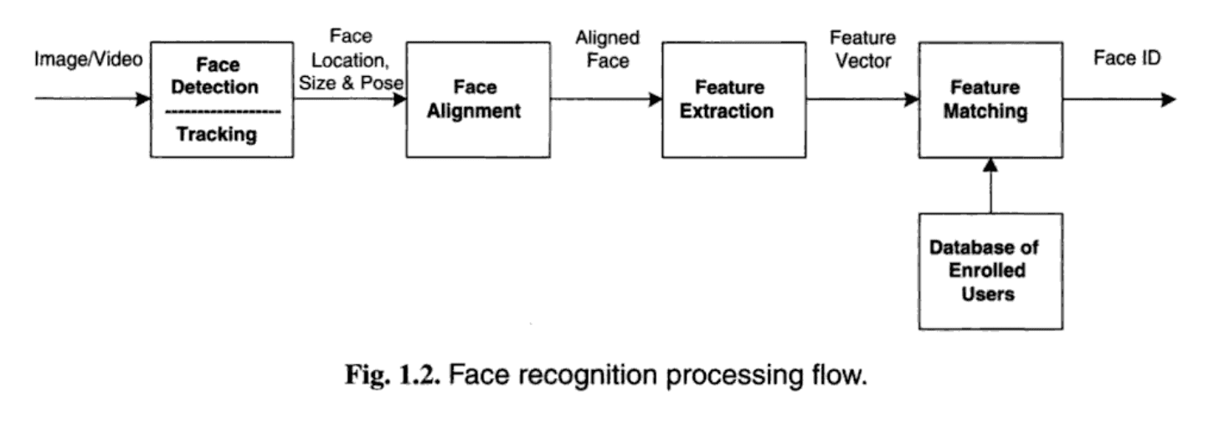
How Facebook uses artificial intelligence for face recognition
Deep learning process that analyzes the pixels in photos you’re already tagged in and generates a string of numbers called a template.
When photos and videos are uploaded to the systems, they compare those images to the template.
Notes:
1. When a Facebook user with either “tag suggestions” or “face recognition” turned on is tagged in a photo, the social network’s machine learning systems analyze the pixels of the face in the image, creating what’s called a “template.” Facebook describes the template as a “string of numbers,” but each user is assigned a template that’s unique to them.
2. When new photos are uploaded, Facebook compares faces present in the image to templates of relevant users and suggests a tag if there’s a match.
3. These templates are voluntary: You only have a template if you have tag suggestions or face recognition enabled. If you decide to turn off tag suggestions or the new face recognition features, Facebook says the templates are deleted. However, you can re-enable the features.

Slide 4
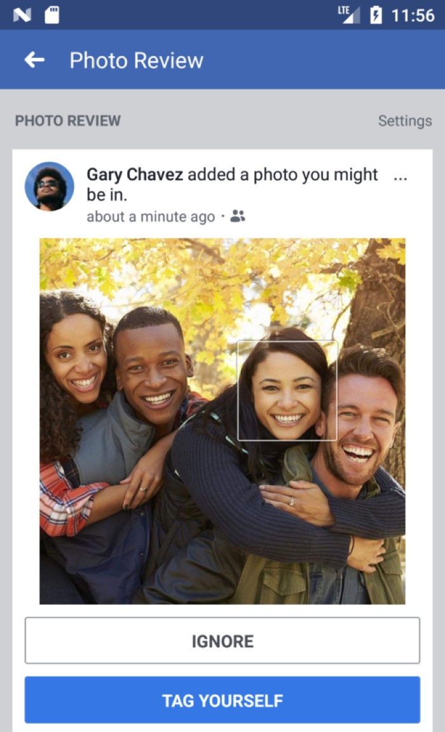
What are the new face recognition features?
Receive notifications when you appear in other people's posts
Know when someone is using your image as a profile photo
Vision impaired users can hear aloud who’s in photos they come across
Notes:
1. Facebook will alert you when photos of you are uploaded, even if you haven’t been tagged in them. This happens even if you aren’t friends with the person who uploaded the photo
(so long as you’re included the audience group specified by the uploader’s privacy settings.)
2. Facebook will alert you if your face is included in a profile picture. This update is aimed squarely at preventing catfishing style attacks and prevent people from impersonating others on Facebook.
3. Finally, visually impaired users can now hear aloud who’s tagged in photos alongside them. They can also know who appears in photos in their News Feed even if people aren’t tagged.

Slide 5
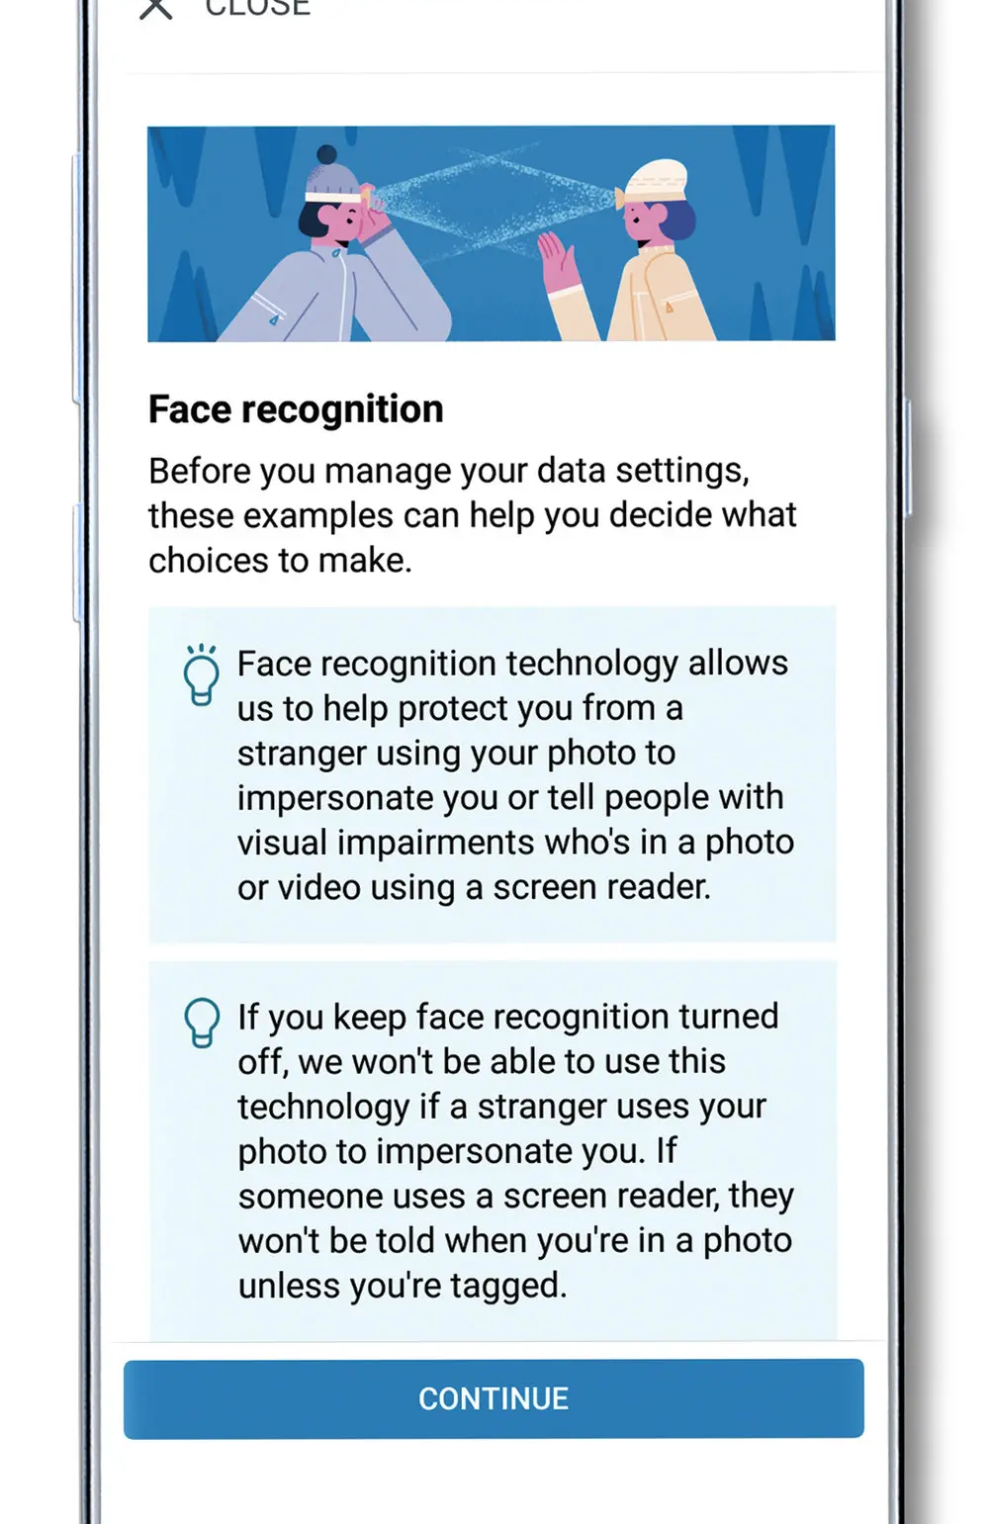
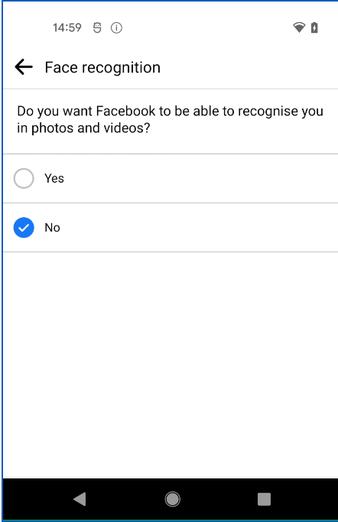
OPT IN OR OPT OUT?
A single “on/off” control.
Notes:
You control whether Facebook can recognize you in photos and videos.
If you have tag suggestions turned off, the new facial recognition features will be turned off by default and will remain that way until you decide to change it.
If you decide to turn it on, the system will use images in which it already knew you appeared in order to train its recognition software to identify you elsewhere on facebook.

Slide 6
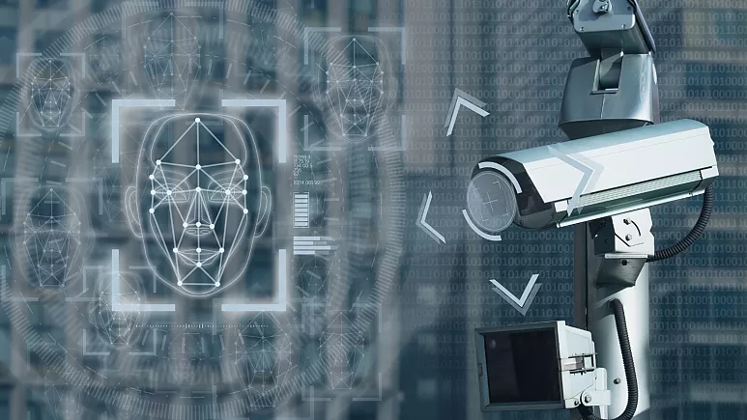
Privacy concerns
Facebook's face recognition technology collects biometric data, which is sensitive personal information
Facebook's face recognition technology could be used to track people's movements and activities
Facebook's face recognition technology could be used for surveillance purposes
Notes:
Biometric data is unique to an individual and can be used to identify them, even if they are not aware of it. This data can be used to create a digital profile of a person, which can be used for targeted advertising or other purposes.
For example, if someone posts a photo of themselves at a particular location, Facebook's face recognition technology could be used to track their movements and identify their location in other photos.
Some people worry that law enforcement agencies could use the technology to identify protesters or other individuals who are exercising their rights to free speech.

Slide 7
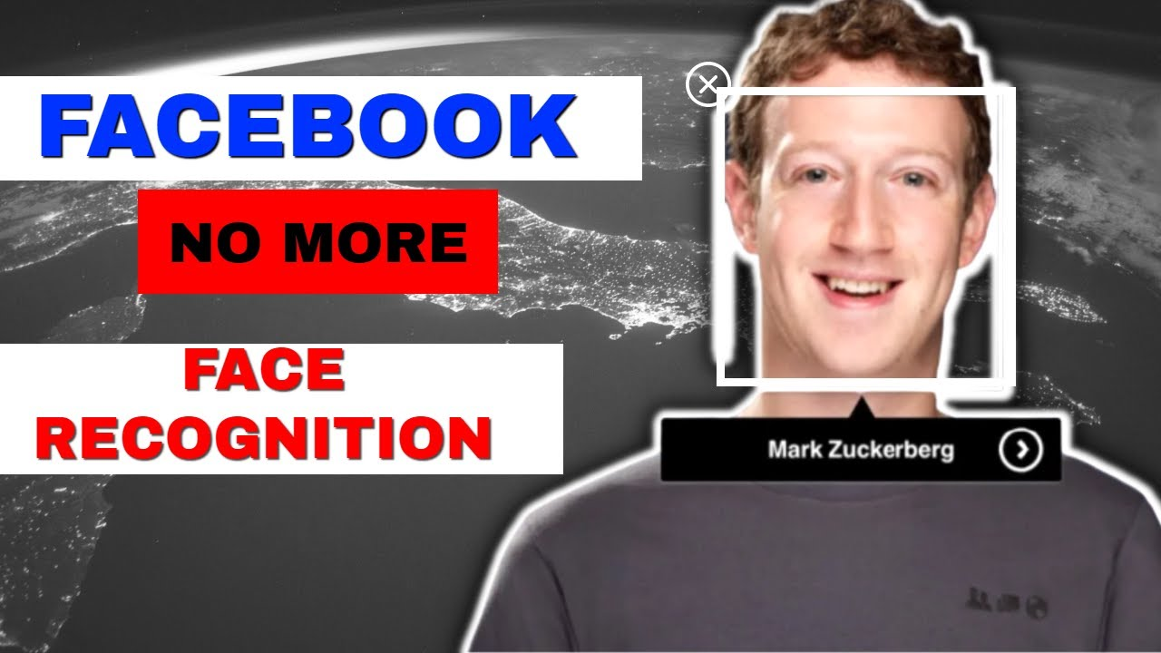
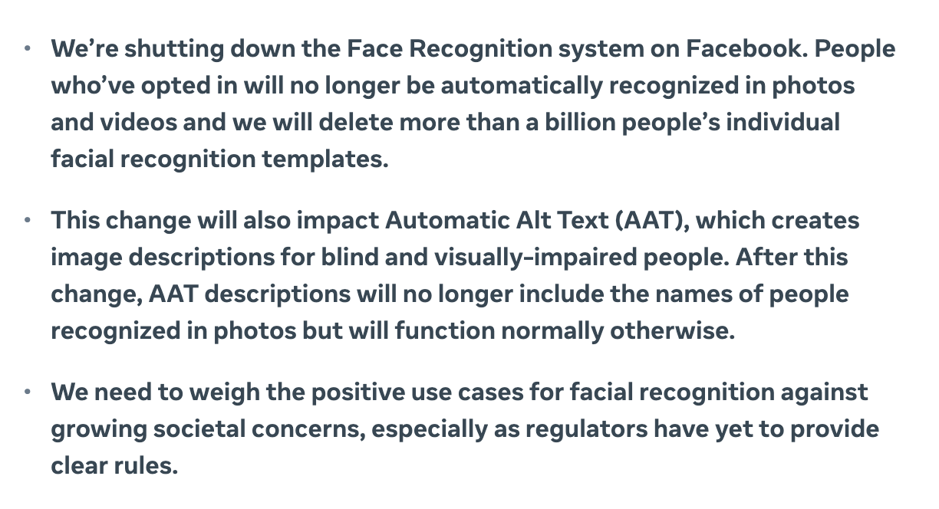
Update (2021) a Message from Facebook
Notes:
In 2021 facebook announced that they will be shutting down the face recognition system and deleting the existing database of facial recognition data. This decision was made as part of Facebook's efforts to improve its privacy practices and increase user control over their data. And went to effect in 2022.
As part of its decision to end the facial recognition feature, Facebook stated that it would no longer automatically recognize people in photos, and it would also stop using facial recognition for other features like friend suggestions. Instead, they would focus on providing users with more control over their data and privacy settings. For example, users can still manually tag their friends in photos, so that’s still an option.

